Slide 1

Global Distribution and Rise of Autoimmune Diseases
Alvin D. Anderson - 2020
Data Source for this Project:
World Bank GDP - 2017
Global Burden of Disease Collaborative Network.
Global Burden of Disease Study 2017 (GBD 2017) Results.
Seattle, United States: Institute for Health Metrics and Evaluation (IHME), 2018.
Available from http://ghdx.healthdata.org/gbd-results-tool.

Slide 2
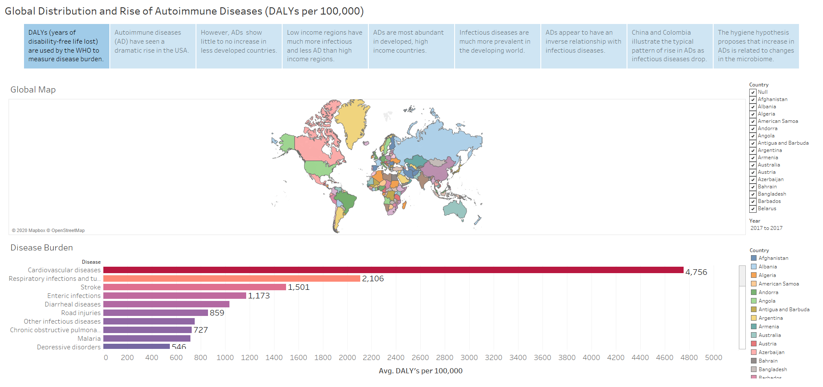

Slide 3
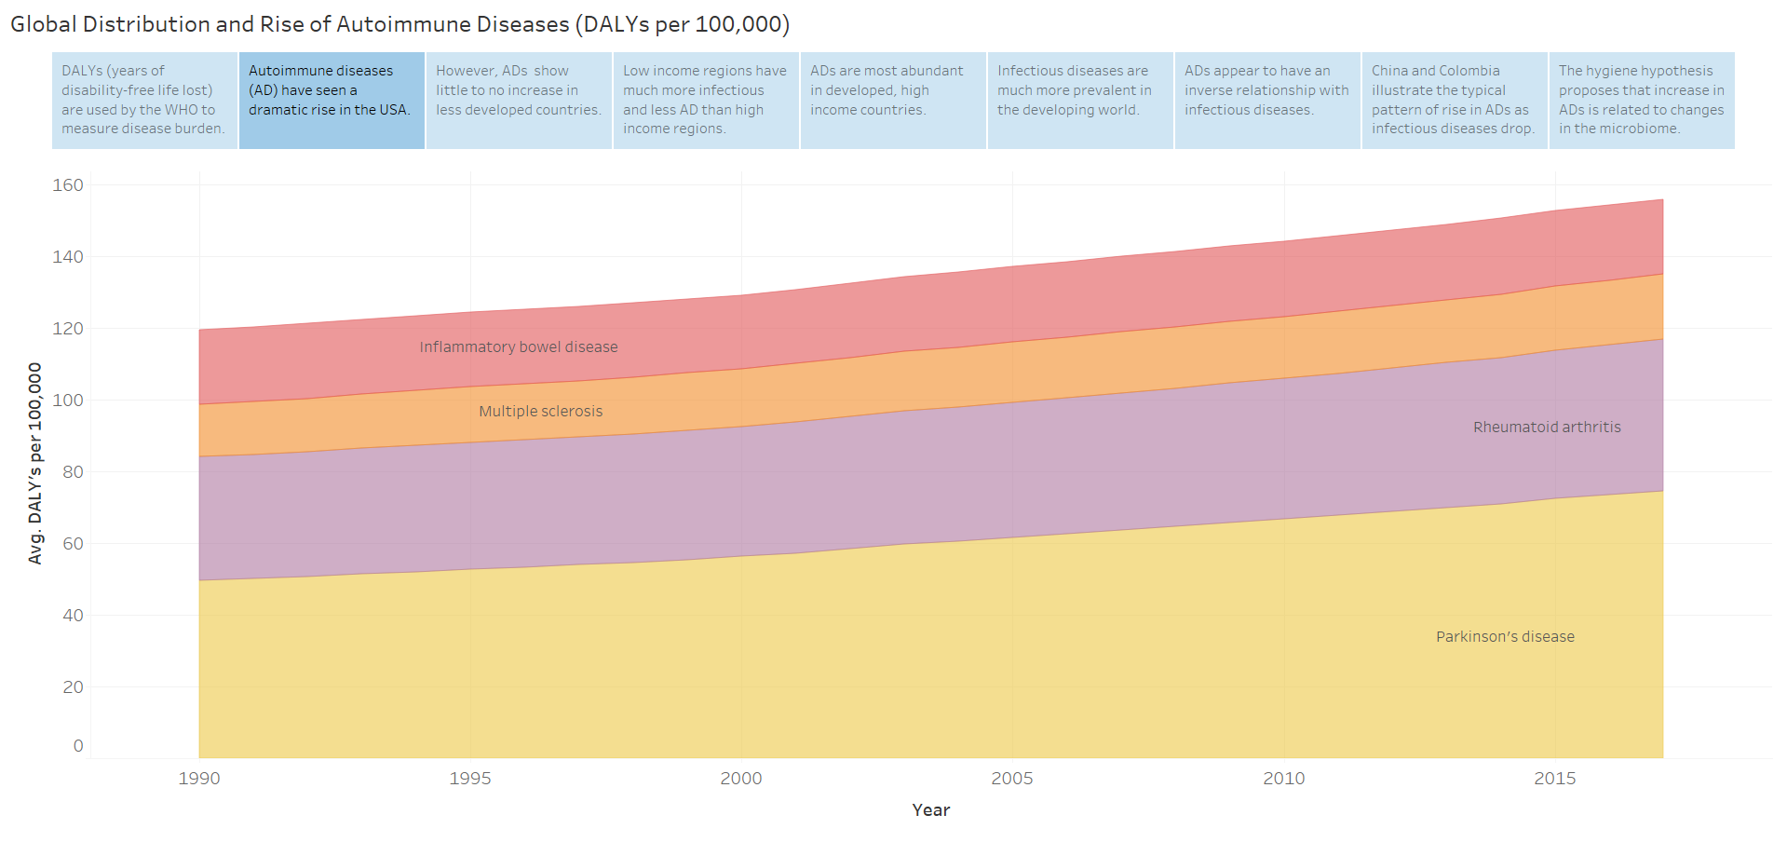

Slide 4
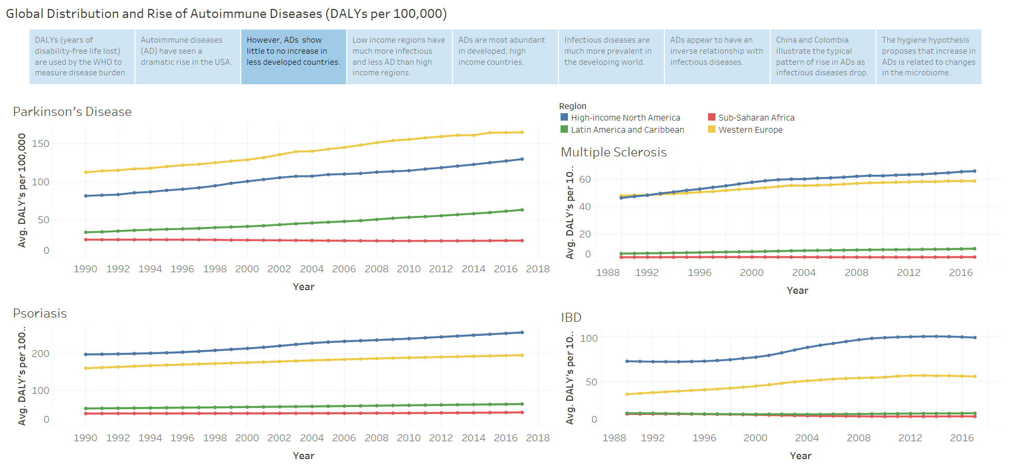

Slide 5
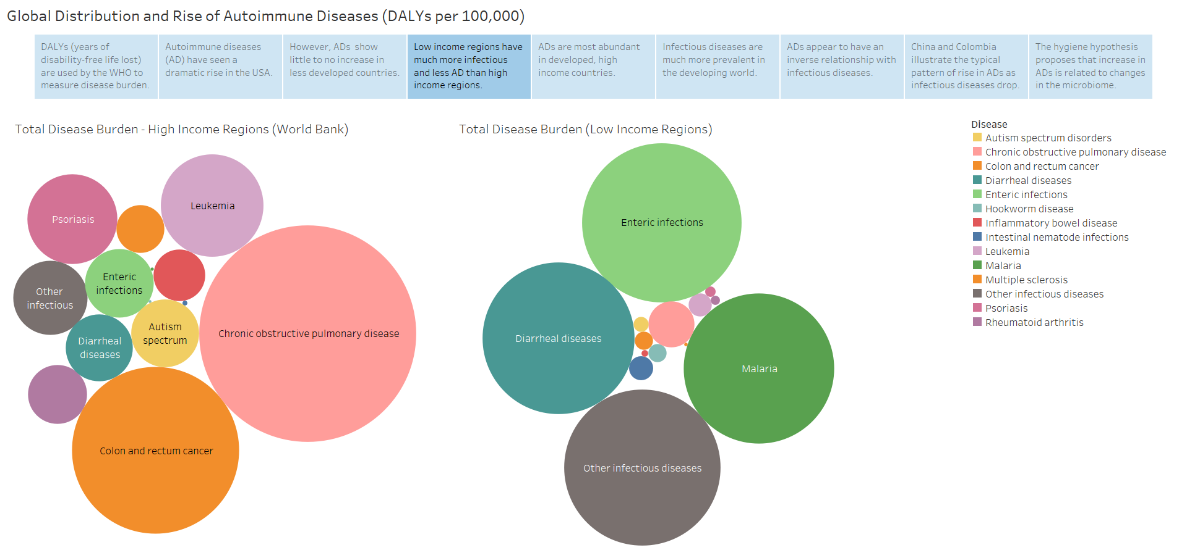

Slide 6
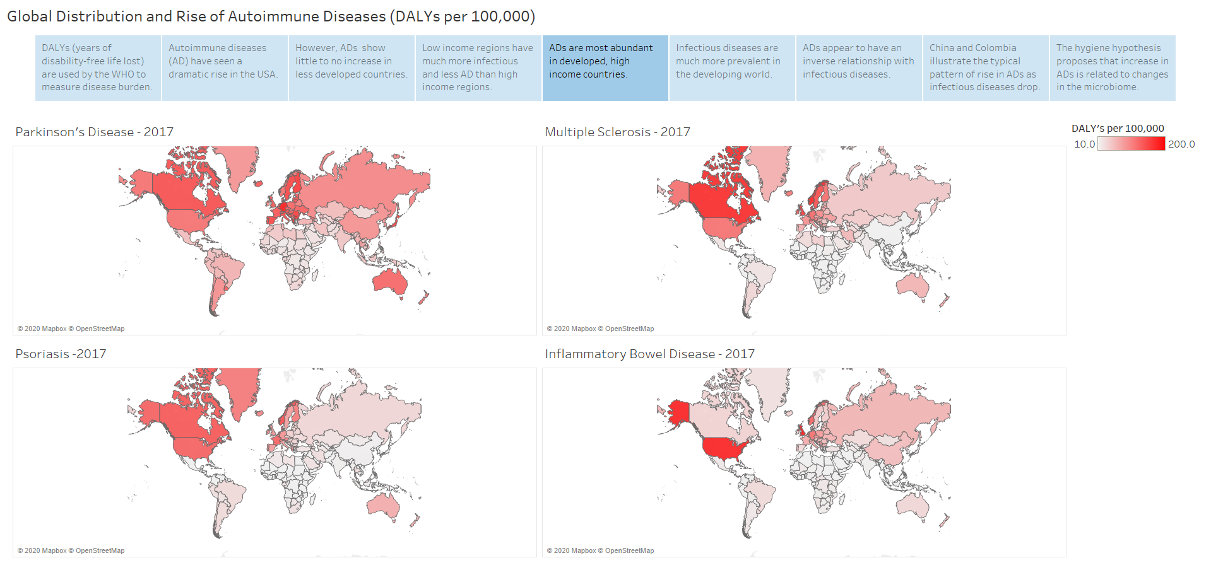

Slide 7
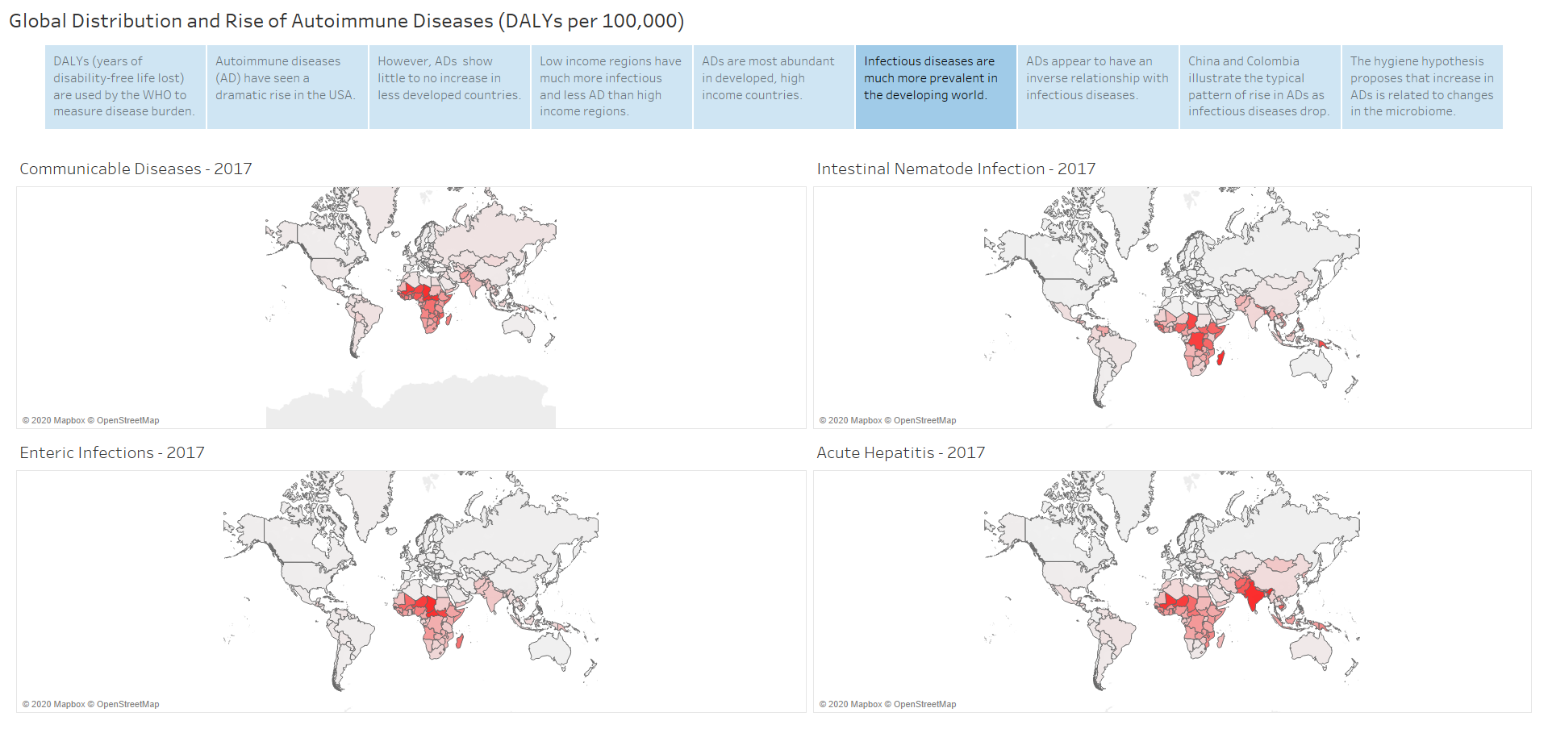

Slide 8
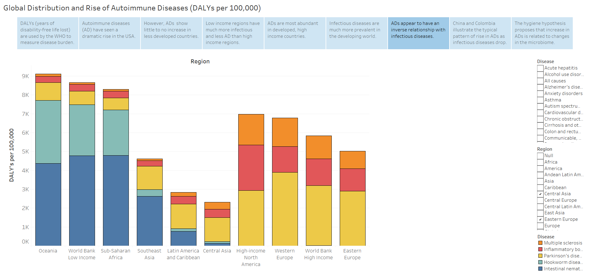

Slide 9
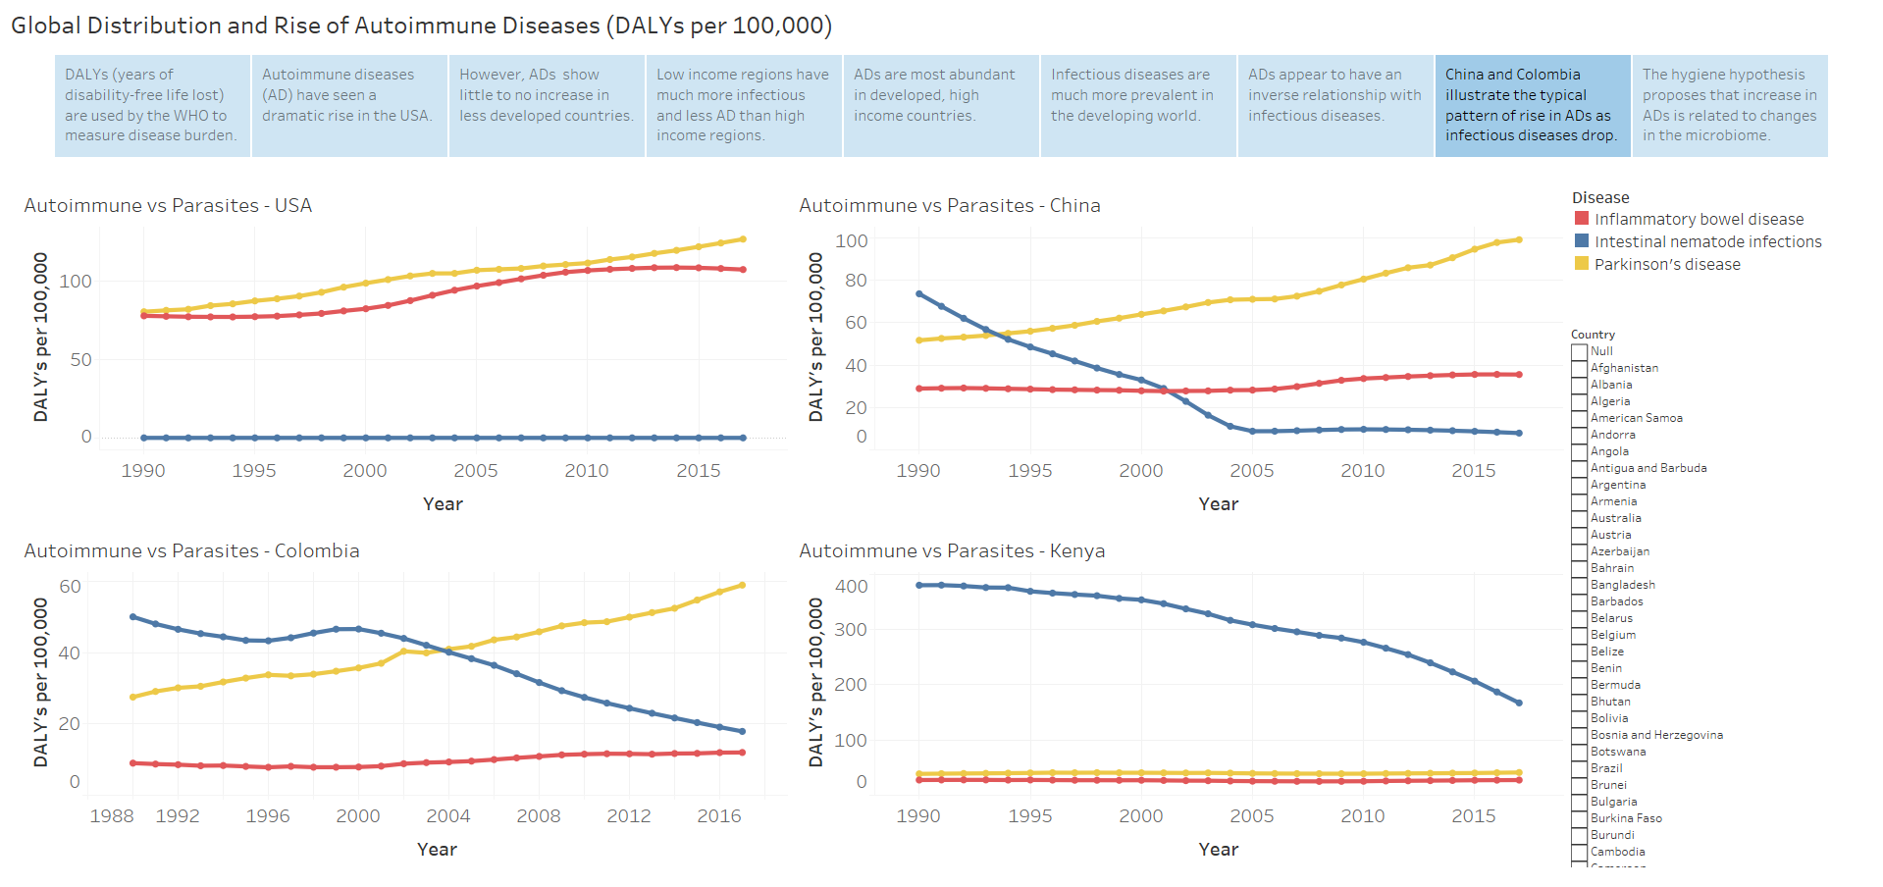

Slide 10
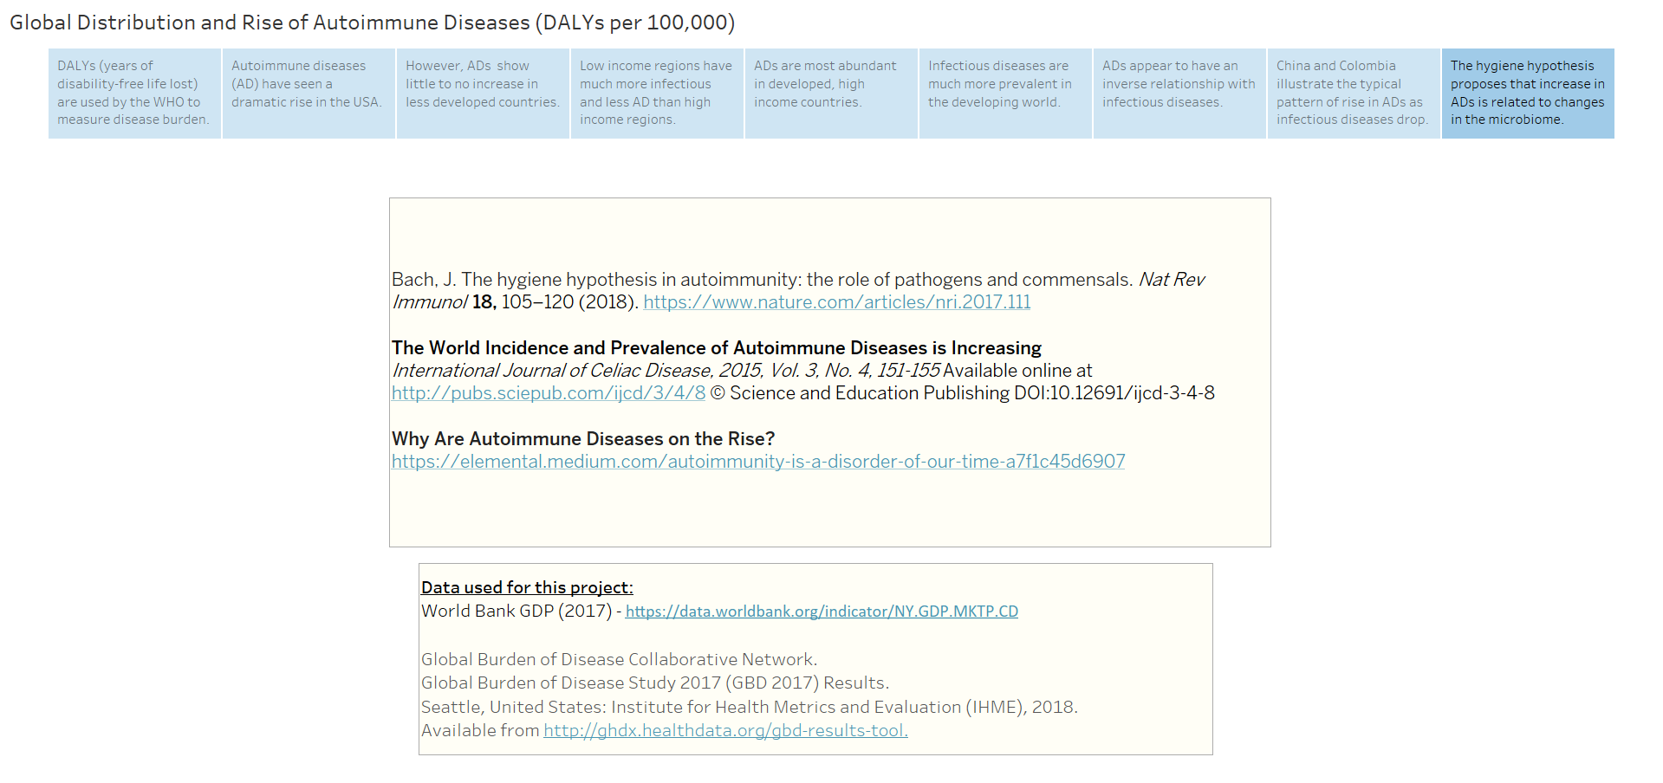

Slide 11
Bach, J. The hygiene hypothesis in autoimmunity: the role of pathogens and commensals. Nat Rev Immunol 18, 105–120 (2018). https://www.nature.com/articles/nri.2017.111
The World Incidence and Prevalence of Autoimmune Diseases is Increasing
International Journal of Celiac Disease, 2015, Vol. 3, No. 4, 151-155 Available online at http://pubs.sciepub.com/ijcd/3/4/8 © Science and Education Publishing DOI:10.12691/ijcd-3-4-8
Why Are Autoimmune Diseases on the Rise?
https://elemental.medium.com/autoimmunity-is-a-disorder-of-our-time-a7f1c45d6907
Data used for this project:
World Bank GDP (2017) - https://data.worldbank.org/indicator/NY.GDP.MKTP.CD
Global Burden of Disease Collaborative Network.
Global Burden of Disease Study 2017 (GBD 2017) Results.
Seattle, United States: Institute for Health Metrics and Evaluation (IHME), 2018.
Available from http://ghdx.healthdata.org/gbd-results-tool.

Slide 12
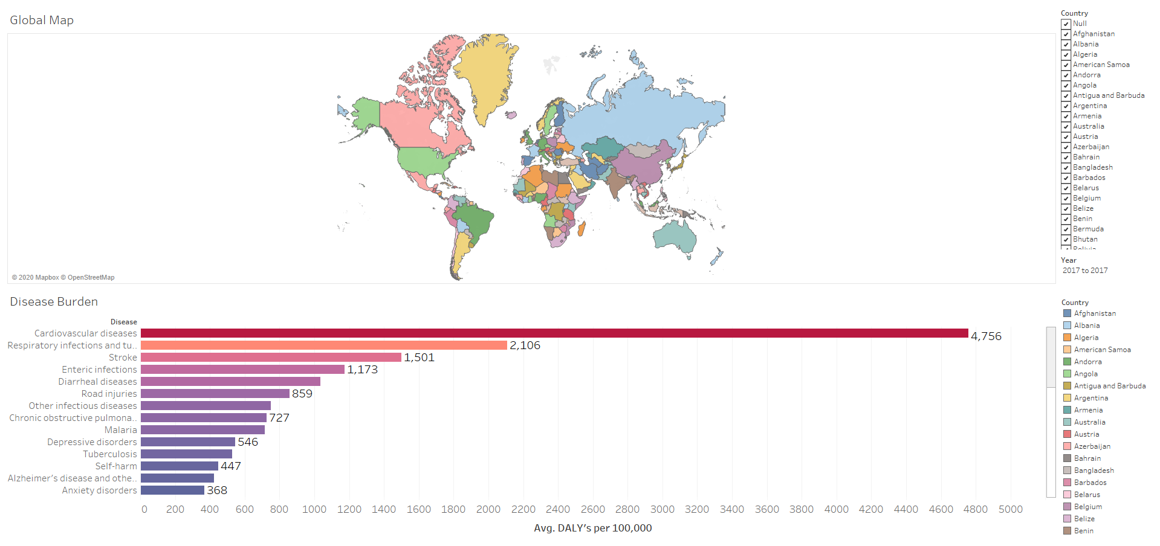

Slide 13
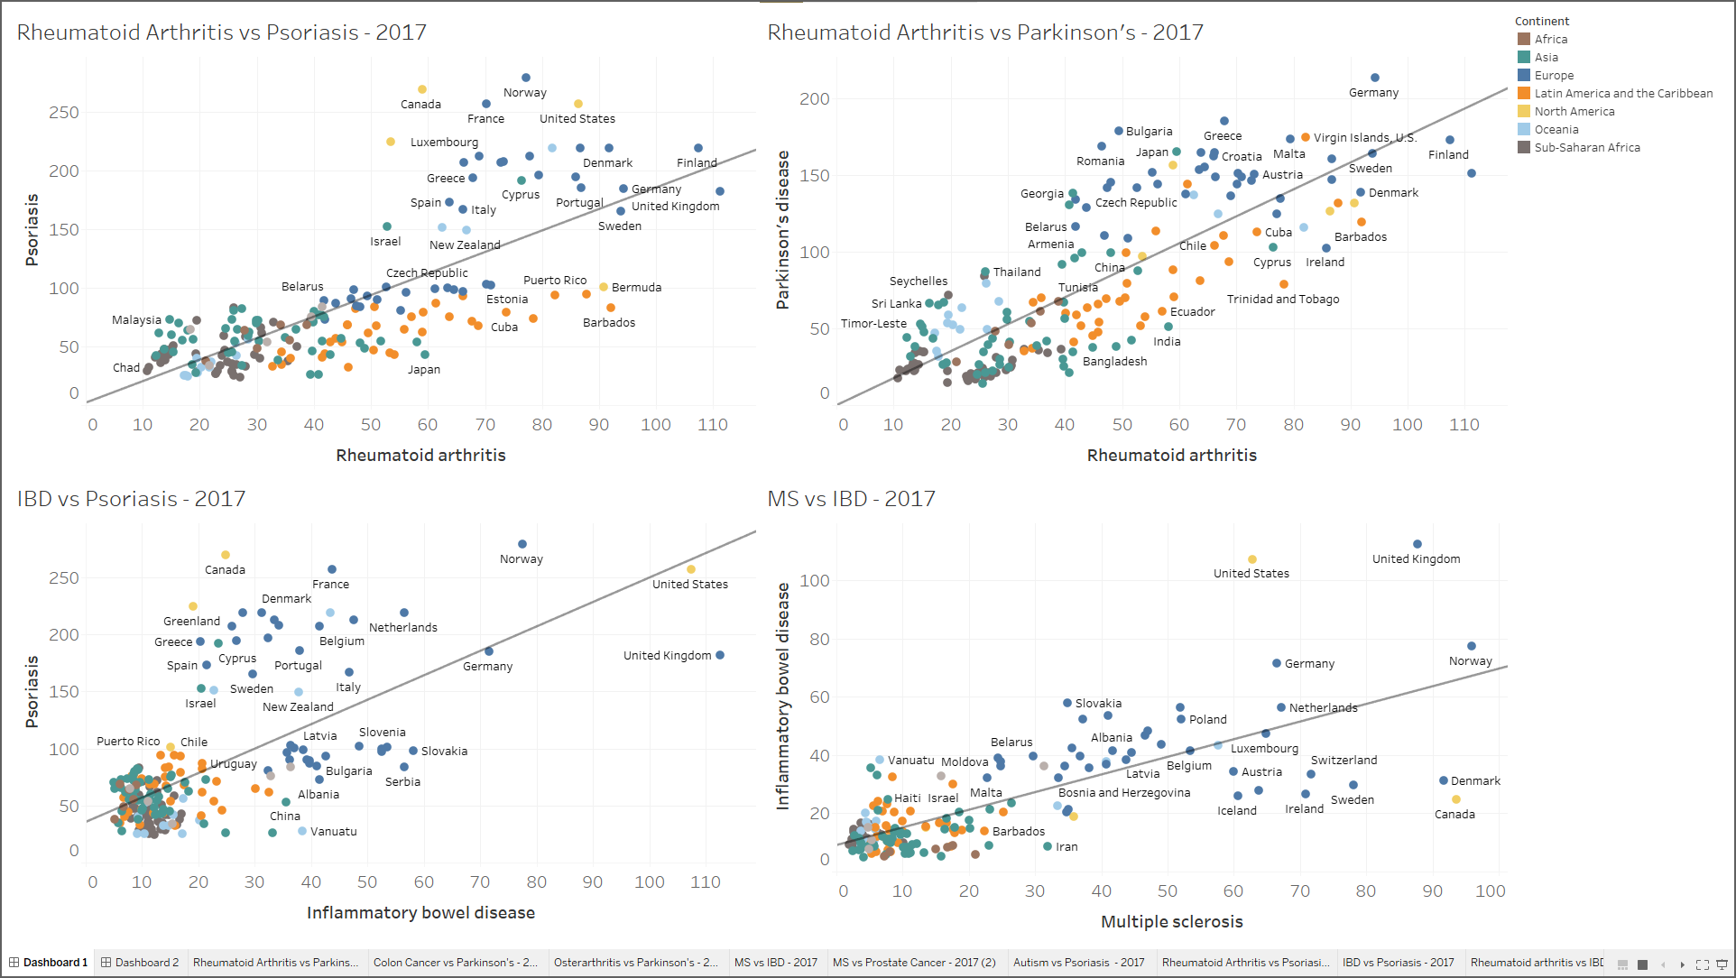

Slide 14
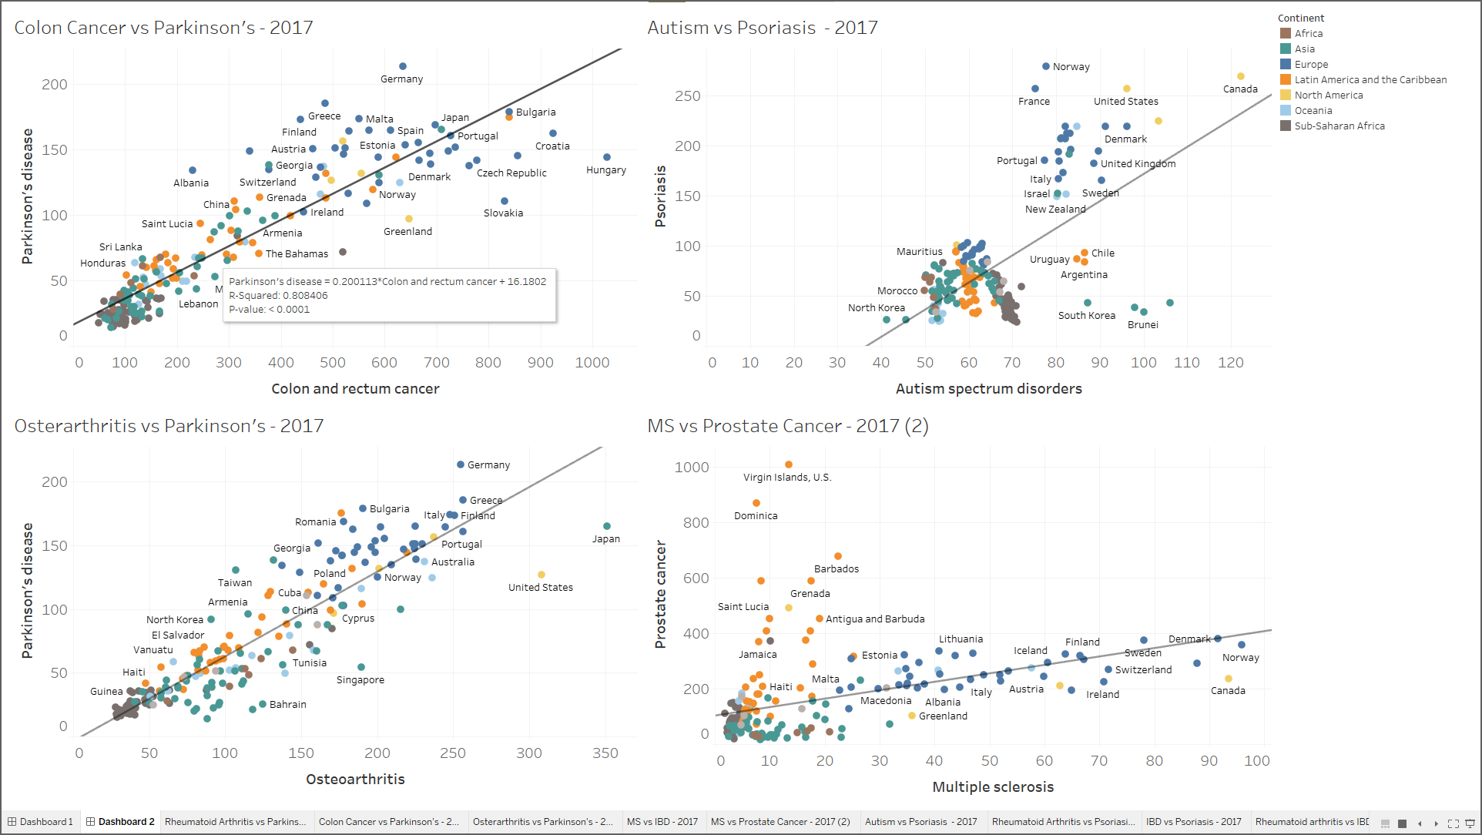

Slide 15
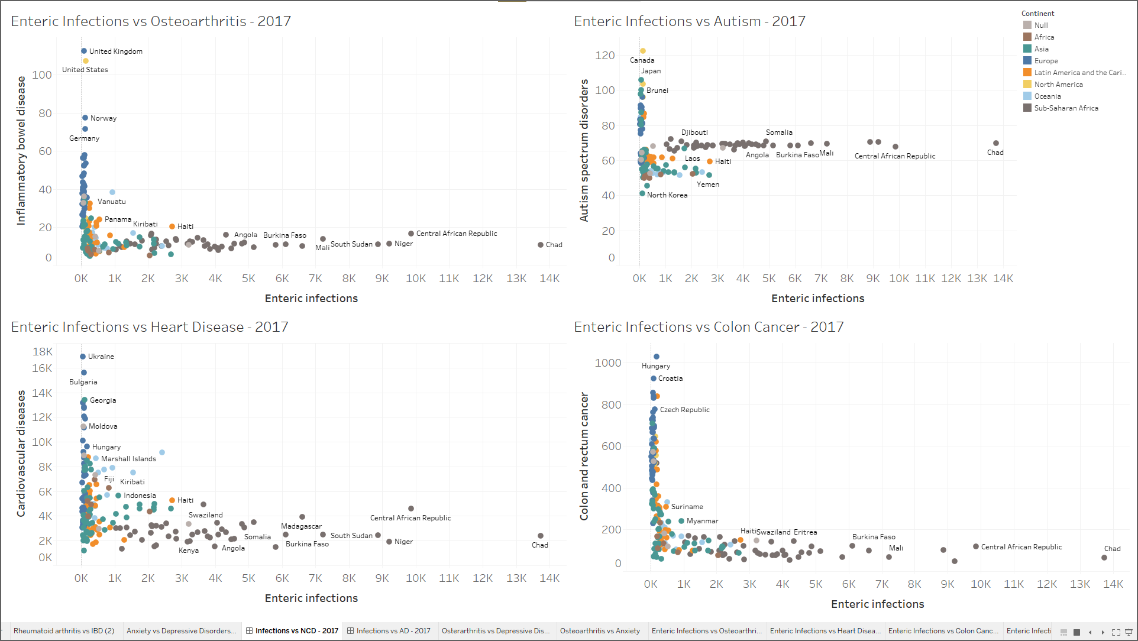

Slide 16
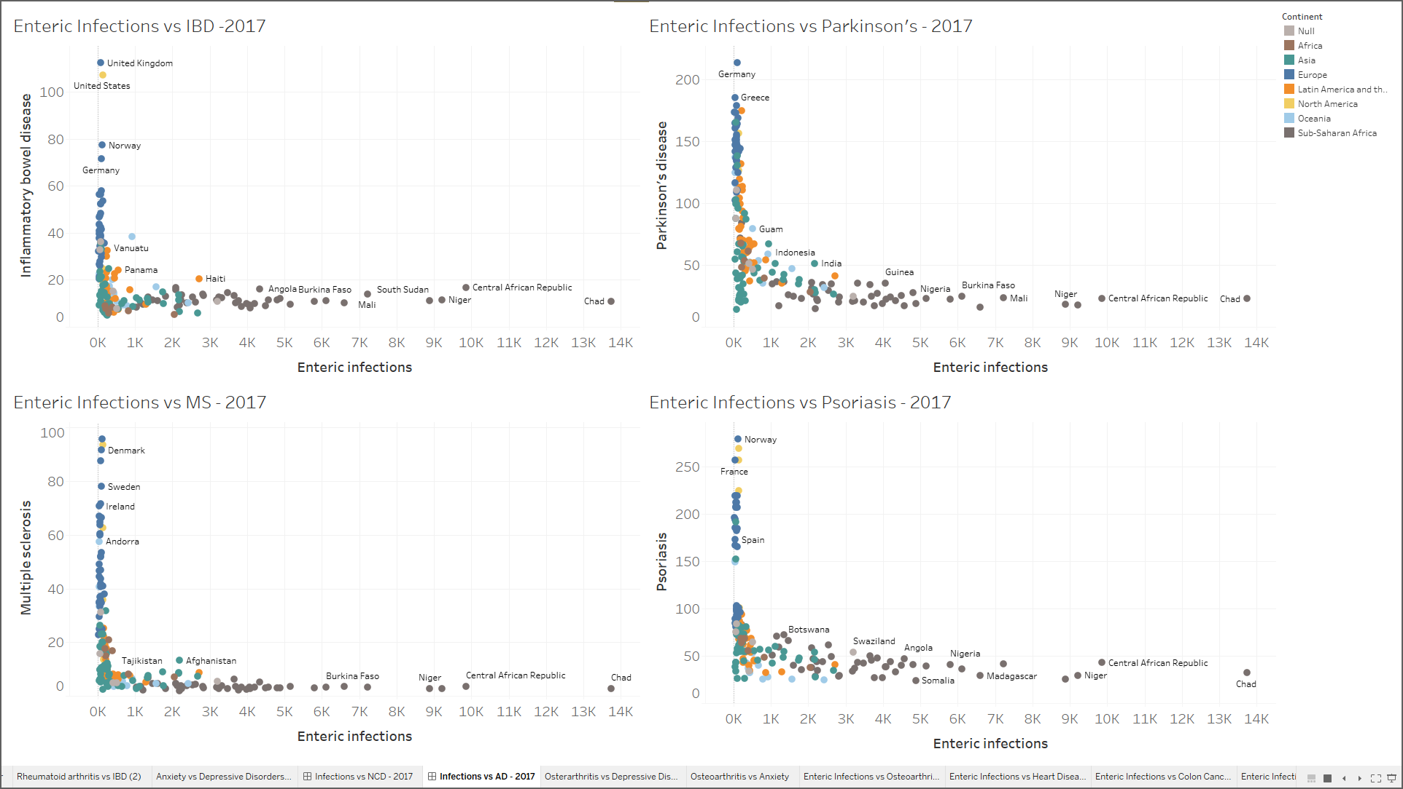

Slide 17
